Slide 1
Class reuse in another project
Object oriented programming

Slide 2
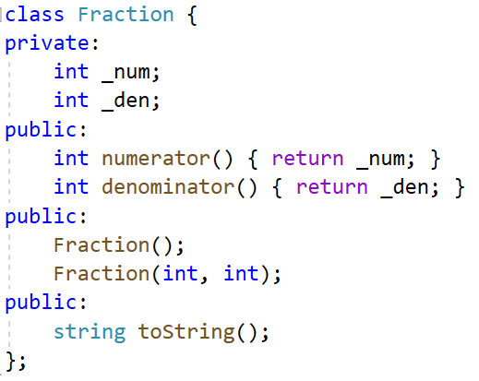
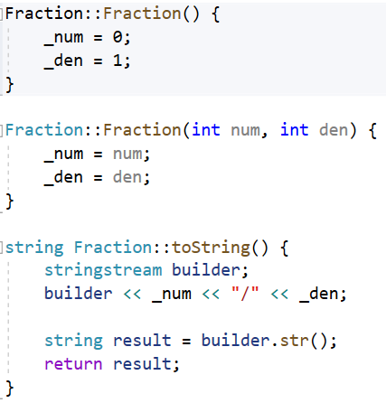
Step 01: Create Fraction project to reuse

Slide 3
Objective
In another project in the same solution, we want to reuse the Fraction class
We want to use the Fraction.h and Fraction.obj file

Slide 4
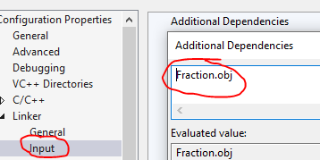
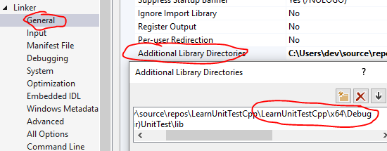
Step 02: Reuse class Fraction in another project
Configuration Properties > Linker > Input page, then select Additional Dependencies.
Edit, add .obj files. (Don't use full path)
Configuration Properties > Linker > General page, then select Additional Library Directories.
Edit, add full path folder
(We need the folder that contains .obj file)

Slide 5
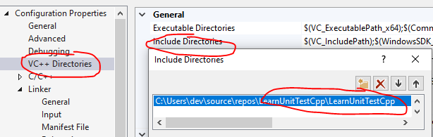
Step 03: Add .h include folder
Select the Configuration Properties > VC++ Directories page, then select Include Directories.
The path is the folder that contains your Fraction.h file!

Slide 6
Step 04: Normal include in another project
#include “Fraction.h”

Slide 7
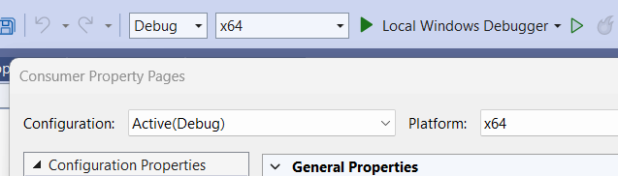
Note
It’s very important to verify that you are configuring for your current active project!

Slide 8
Submission notice (readme.txt / md)
Take note about your including!

